Slide 1




LICENSE PLATE DETECTION

Slide 2



OUR TEAM
Afrah Jaber
Raghad Alharbi
Hanan Hamdan
Rahaf
Alzahrani
Drew Holloway

Slide 3
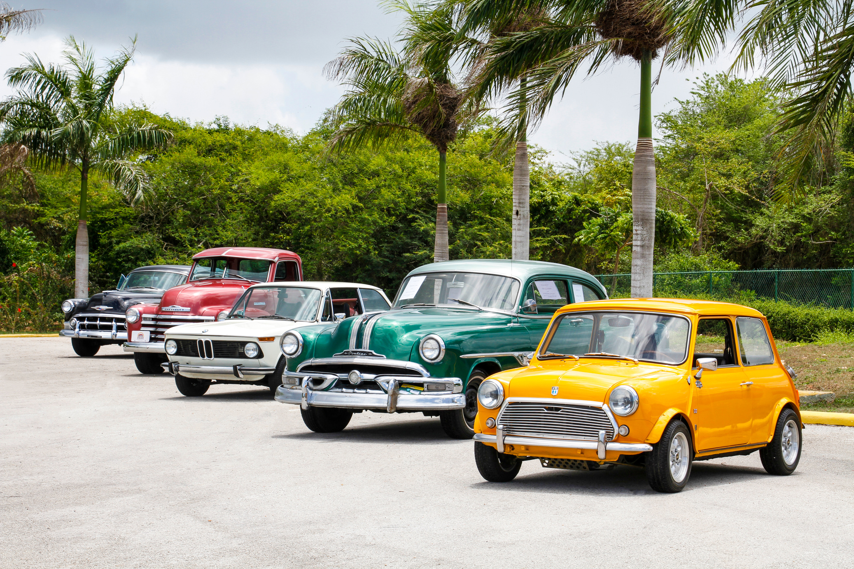
Content
01
problem statment
02
Project Overview
03
Methodology
04
Model description:s
05
Model Evaluation
06
Results
10
Challenges & Future developments

Slide 4
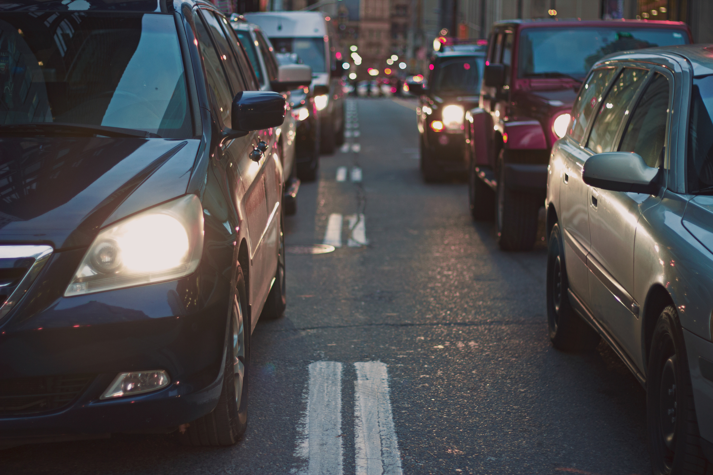

PROBLEM STATMENT
PROBLEM STATMENT
In traffic monitoring systems, you need a system capable of detecting and identifying license plates in images accurately and quickly. The main problem includes having to deal with a wide variety of license plate designs, different lighting conditions, and contrasting backgrounds.
In traffic monitoring systems, you need a system capable of detecting and identifying license plates in images accurately and quickly. The main problem includes having to deal with a wide variety of license plate designs, different lighting conditions, and contrasting backgrounds.

Slide 5

Project Overview
Objective: Develop a model for detecting license plates in images and videos using YOLOv8.
Importance: Applications in traffic monitoring, security, and vehicle recognition.

Slide 6
METHODOLOGY
Data Preparation
Model Training
Model Testing
Data Loading: Used image_dataset_from_directory to load images and labels.
Data Splitting: Split the dataset into 80% training and 20% validation.
Framework: YOLOv8
Model: yolov8s.pt
Epochs: 1
Batch Size: 32
Predictions: Tested on new images and videos
2
4
6
1
3
5
Data Collection
Data Augmentation
Model Evaluation
Metrics: Mean Average Precision (mAP), Precision, Recall
Techniques: Random horizontal flip, rotation up to 10%, zoom up to 10%, rescaling [0, 1]
The dataset contains images of vehicles with annotated license plates for training the detection model.

Slide 7


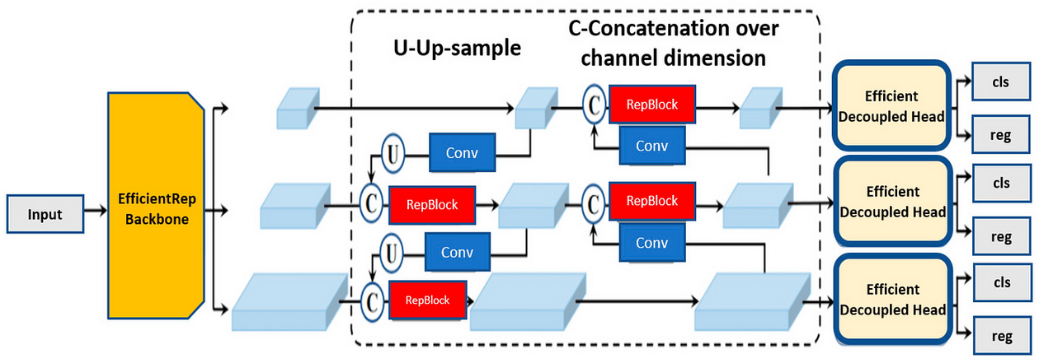
Model description:
YOLO is suitable for this task due to its real-time object detection capability. It excels in both accuracy and speed when identifying bounding boxes around objects.

Slide 8



Model Evaluation
mAP
Precision
Recall
0.654351027896049
0.80704
0.92944

Slide 9
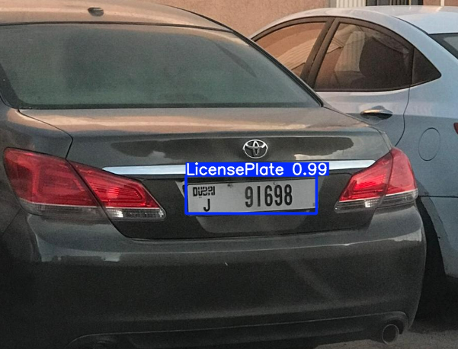
RESULTS

Slide 10
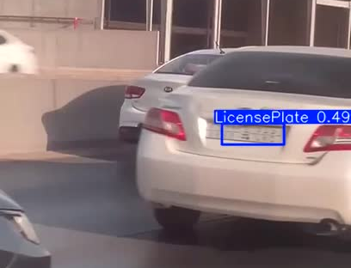
RESULTS

Slide 11


CHALLENGES
FUTURE DEVELOPMENTS
01
01
Integrate the license plate detection system with law enforcement databases and vehicle management systems.
Variability in lighting, weather conditions, and image quality can affect model performance.
02
Training a model on large datasets can be computationally intensive and time-consuming.
02
Expand the model to recognize license plates from various countries and regions.
03
03
Train the model to handle various environmental conditions, such as different lighting, weather, and angles.
Different countries and regions have varying license plate designs, fonts, and sizes.

Slide 12
Thank You
We conclude by emphasizing the necessity of addressing the problem of traffic congestion in a comprehensive and integrated manner, to ensure improving the quality of life and facilitating transportation in the future.
www.reallyygreatsite.com
September 2024

